Slide 1
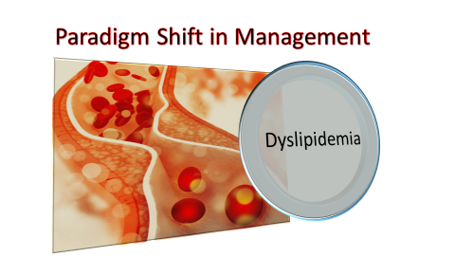
Dr. Samuel Wainaina
(D.Pharm, Bpharm, MSc )

Slide 2
Outline
Introduction
Definition of terminologies
Lipoprotein disorders
Types of dyslipidemia
Approaches to Management
Role and responsibility of pharmacy professionals in Infestation control
Summary

Slide 3
Objectives
Explain various approaches to management of Dyslipidemia
Sate personal responsibility in reducing the risk of dyslipidemia and CHD
Describe lipid metabolism

Slide 4
Introduction
Plasma lipids are transported in complexes called lipoproteins
Metabolic disorders of elevated of lipoproteins are called hyperlipoproteinemia or hyperlipidemias
Hyperlipemia denotes hypertriglyceridemia or increased levels if triglycerides
Hyperlipemia is a risk factor of acute pancreatitis
Hyperlipoproteinemia precipitates atherosclerosis
Dyslipidemia is Major risk factor in CVDs.

Slide 5
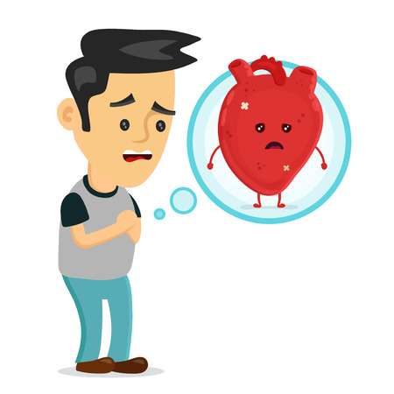
What is Dyslipidemia?
Definition:
Dyslipidemia is
elevation of plasma cholesterol, triglycerides (TGs), or both, or
a low HDL cholesterol level that contributes to the development of atherosclerosis

Slide 6

Do we need Cholesterol?
It’s a Component of cell membranes
Synthesis of certain hormones
synthesis of bile salts
Reducing evaporation at stratum corneum
blocks transdermal absorption of water-soluble compounds

Slide 7
Increased ingestion of cholesterol inhibits endogenous cholesterol synthesis
Increase in dietary saturated fats produces a substantial (15% to 25%) increase in circulating cholesterol
Sources of Cholesterol
Exogenous
Endogenous
Because the liver uses saturated fats to make cholesterol
More cholesterol comes from endogenous Synthesis than from the diet
Synthesis is catalyzed by HMGCoA reductase

Slide 8
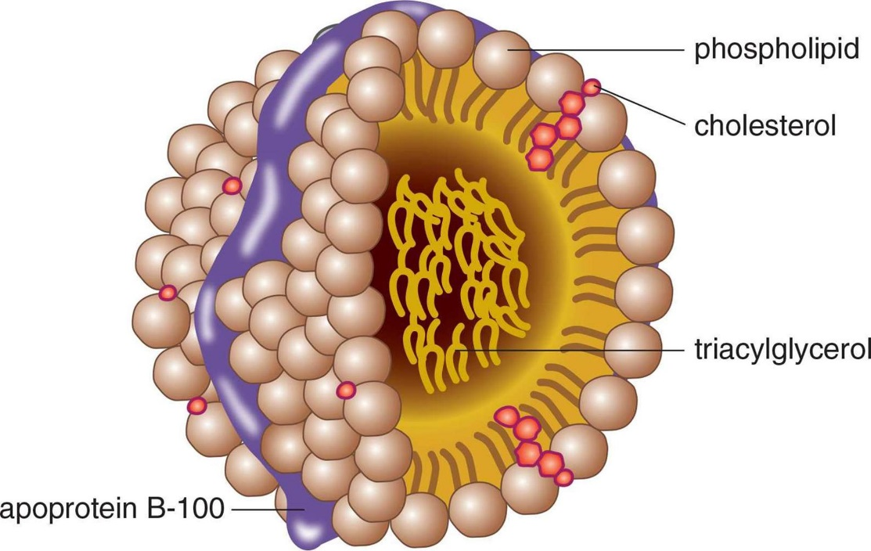
How Is Cholesterol Transported?
Lipoproteins
serve as carriers for transporting lipids—cholesterol and triglycerides—in blood
Tiny, spherical structures
Hydrophobic core, composed of cholesterol and triglycerides, surrounded by a hydrophilic shell

Slide 9
Apolipoproteins.
They constitute the protein component of lipoproteins, have three functions:
They serve as recognition sites for cell-surface receptors, and thereby allow cells to bind with and ingest lipoproteins.
They activate enzymes that metabolize lipoproteins.
They increase the structural stability of lipoproteins

Slide 10
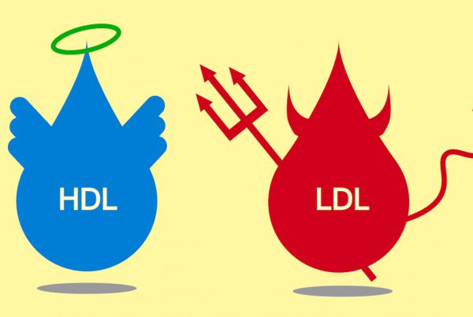
Notable Facts
The apolipoproteins of greatest clinical interest are labeled A-I, A-II, and B-100.
Lipoproteins with apolipoprotein B-100 take cholesterol to Tissues
Lipoproteins with apolipoprotein A-I take cholesterol from tissues

Slide 11
Classes of Lipoproteins
There are six major classes of plasma lipoproteins.
Naming of lipoprotein types is based on their density.
Classes of lipoproteins differ in density because they differ in their percent composition of lipid and protein.
Because protein is denser than lipid,
lipoproteins that have a high percentage of protein (have a relatively high density.
lipoproteins with a lower percentage of protein have a lower density.

Slide 12
Types of Lipoproteins
Intermediaries
Chylomicrons
Chylomicron remnants
Intermediate Density Lipoproteins (IDL)
Important in Coronary Atherosclerosis
Very-Low Density Lipoproteins
Low Density Lipoproteins( Bad Cholesterol)
High Density Lipoproteins (Good Cholesterol)

Slide 13
Physiologic Roles
VLDLs -deliver triglycerides from the liver to adipose tissue and muscle.
LDL -delivers cholesterol to nonhepatic tissues
It makes the greatest contribution to coronary atherosclerosis.
When cellular demand for cholesterol increases, cells synthesize more LDL receptors and thereby increase their capacity for LDL uptake.
Cells that are unable to make more LDL receptors cannot increase cholesterol absorption

Slide 14
HDLs -carry cholesterol from peripheral tissues back to the liver.
Therefor HDLs promote cholesterol removal
Not all HDL particles are the same. Some contain only apolipoprotein A-I, whereas others contain apolipoproteins A-I and A-II.
Cardioprotection is conferred by the HDLs that contain only apolipoprotein A-I.

Slide 15
Steps of Atherosclerosis
LDL Transport to endothelial Cells
LDL reached Sub-endothelial Space
LDL Undergoes Oxidation
Monocytes migrate to Sub-endothelial Space
Monocyte s converted to macrophages
Macrophages mobility become inhibited
Oxidized LDL undergo Uptake by macrophages
The material become cytotoxic and damage the endothelium
Platelet Adhesion and formation of microthrombi

Slide 16
Causes of Dyslipidemia
Primary Causes
Genetic Causes(Familial Disorders)
Secondary Causes
A sedentary lifestyle with excessive dietary intake of total calories, saturated fat, cholesterol, and trans fats
Diabetes
Alcohol overindulgence
Drugs
Hypothyroidism
Multiple gene mutations that result in either overproduction or defective clearance of triglycerides and LDL, or in underproduction or excessive clearance of HDL

Slide 17
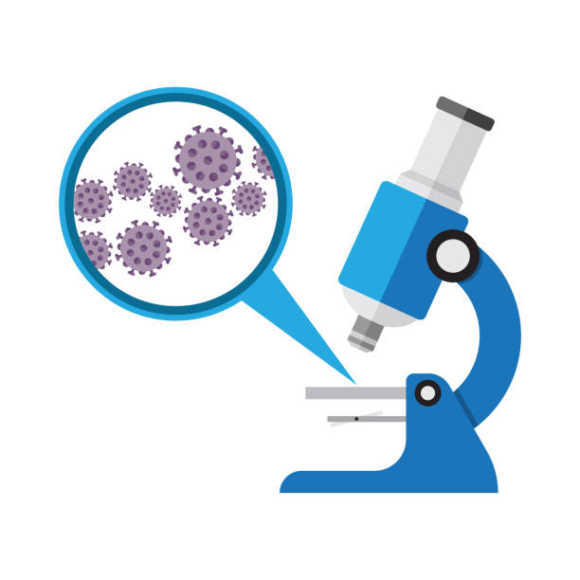
Detection & Evaluation
Lipoprotein disorders are detected by lipids in serum after a 10-hour fast.
Risk of heart disease is concentration of artherogenic lipoproteins.
Risk of CHD is inversely related to levels of HDL
Differentiation of familial disorders is by identification of Lipoproteins involved.

Slide 18
Serum Levels of Lipoproteins
 | Desirable | Borderline to high | High
Total Cholesterol | <200mg/dL | 200-239mg/dL | >240mg/dL
LDL-Cholesterol | <130mg/dL | 130-159mg/dL | >160mg/dL
HDL- Cholesterol |  |  | >60mg/dL
Men | >40mg/dL
Women | >50mg/dL
Triglycerides | <120mg/dL | 120-199mg/dL | >200mg/dL

Slide 19
Approaches to Management
Therapeutic Lifestyle Change
Diet
Pharmacotherapy
2nd Line To TLC
Weight Control
Exercise
In TLC Failure
Elevated+ CHD Risks

Slide 20
Therapeutic Lifestyle Change
The TLC Diet.
This diet has two objectives:
Reducing LDL cholesterol and
Establishing and maintaining a healthy weight
The diet reduces intake of cholesterol and saturated fats:
limit intake of cholesterol to 200 mg/day or less and
intake of saturated fat to 7% or less of total calories.
Minimize Intake of trans fats
(Crackers, Commercial baked foods and French fries)
Increased intake of soluble fiber (Oatmeal)
Increased intake of plant stanols and sterols

Slide 21

Weight Control
Chronic, excessive intake of calories leads to increased concentrations of triglycerides and reduced HDL-C.
Maintain ideal body weight (BMI 20–25 kg/m2)
The Weight loss can reduce both LDL cholesterol and CHD risk
Lipoproteins with apolipoprotein A-I take cholesterol from tissues

Slide 22

Exercise
Regular exercise lowers CHD risk
Running & Swimming decrease LDL-C and elevate HDL-C
Exercise can also
reduce blood pressure,
decrease insulin resistance, and
improve overall CV performance

Slide 23

Smoking Cessation
Smoking Raises LDL-C and Lowers HDL-C
HDL-C
LDC-C
Hence increasing the risk of CHD.
Smokers should be strongly encouraged to quit
Nonsmokers should be urged not to start

Slide 24
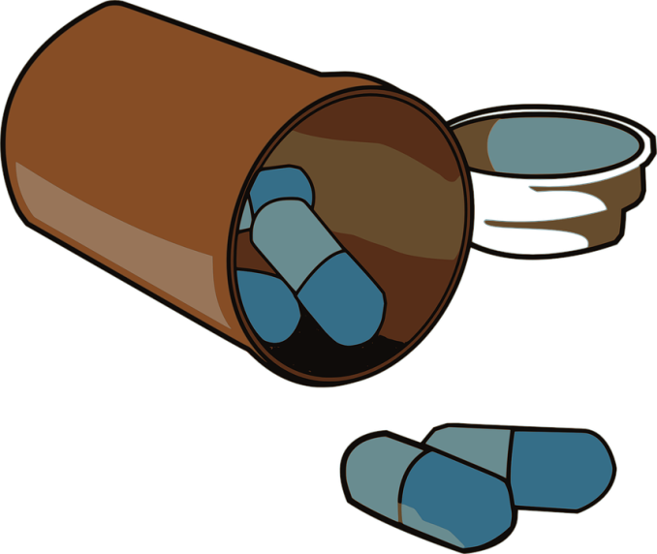
Drug Therapy
Drugs are not the first-line therapy for lowering LDL cholesterol.
Should only be used if TLCs fail to reduce LDL cholesterol to an acceptable
Dietary modification should continues.
Why?
Because the beneficial effects of diet and drugs are additive
Drugs alone may be unable to achieve the LDL goal.

Slide 25
Classification
HMG-CoA reductase inhibitors (Statins):Lovastatin, Simvastatin, Pravastatin, Atorvastatin, Rosuvastatin, Pitavastatin
Bile acid sequestrants (Resins):Cholestyramine, Colestipol, Colesevelam
Lipoprotein lipase activators (Fibrates): Clofibrate, Gemfibrozil, Bezafibrate, Fenofibrate.
Lipolysis and triglyceride synthesis inhibitor (Nicotinic acid).
Sterol absorption inhibitor: (Ezetimibe).

Slide 26
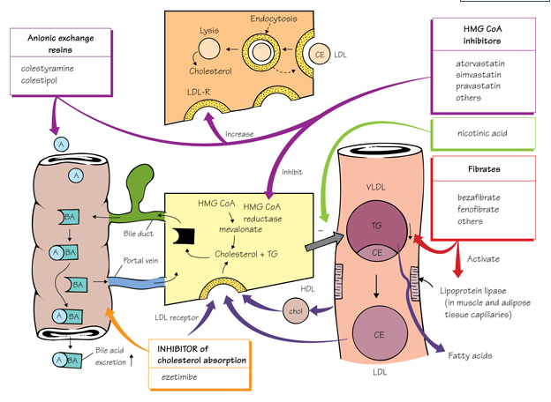
M.O.A of Lipid Lowering Drugs

Slide 27
Class | M.O.A | Effects | Application | Toxicity & interactions
STATINS -Artovastatin -Simvastatin -Rosuvastatin | Inhibit HMG-CoA reductase | Reduce cholesterol synthesis Up-regulate LDL- Rcpts Reduce triglycerides | Artherosclerosis Acute Coronary Syndrome | Myopathy Hepatotoxicity Interact with CYP Inhibitors
FIBRATES -Fenofibrate -Gemfibrozil | Peroxisome proliferator-activated receptor alpha (PPAR-a) agonists | Decrease secretion of VLDL Increase lipoprotein lipase activity Increase HDL | Hypertriglyceridemia Low HDL | Myopathy Hepatic dysfunction
BILE ACID SEQUESTRANTS -Colestipol -Cholestyramine -Colesevelam | Binds bile acids in gut -prevents reabsorption -Increase cholesterol catabolism -Upregulate LDL receptors | Decrease LDL | Elevated LDL Digitalis toxicities Pruritus | Constipation Bloating Interferes absorption of some drugs and vitamins
STEROL ABSORTION INHIBITORS -Ezetimibe | Bloack sterol transporter in intestine brush boerders | Inhibits reabsorption of cholesterol excreted in bile. -decrease LDL and Cholesterol | Elevated LDL Phytosterolemia | Myositis Low incidences of hepatic dysfunction
NIACIN | Decrease catabolism of of apo A-I Reduces VLDL secretion from the Liver | Increase HDL Decrease Lipoprotein(a), LDL and triglycerides | Low HDL Elevated VLDL Elevated LDA Elevated Lp(a) | Gastric irritation Flushing May reduce glucose tolerance

Slide 28
Combined Drug Therapy
Combines drug therapy is useful
When VLDL levels are significantly increased during treatment of hypercholesterolemia with a resin
When LDL and VLDL are both elevated initially
When LDL or VLDL levels are not normalized with a single agent
When elevated level of Lp (a) or an HDL deficiency coexist with other hyperlipidemia.

Slide 29
Fibrates & Bile Acid Binding Resins
Use in treating Patients with familial Combined hyperlipidemia who are intolerant of niacin or statins.
NOTE: It may increase the the risk of Cholelithiasis

Slide 30
Statins & Bile Acid Binding Resins
Useful in the treatment of familial hypercholesterolemia but may not control levels of VLDL in some patients with familial combined hyperlipoproteinemia.
Statins should be given 1 hour before or 4 hours after the resin to ensure absorption

Slide 31
Pharmacy professionals Role and Responsibilities
Educate on prevention and control
Offer advice on Therapeutic Lifestyle Change
Encourage detection and evaluation
Carry out medication Therapy Management

Slide 32





Thank You!

